Slide 1
Neuromuscular junction
Dr Reshmy K. R
Prof & Head
Dept of Physiology& Biochemistry

Slide 2
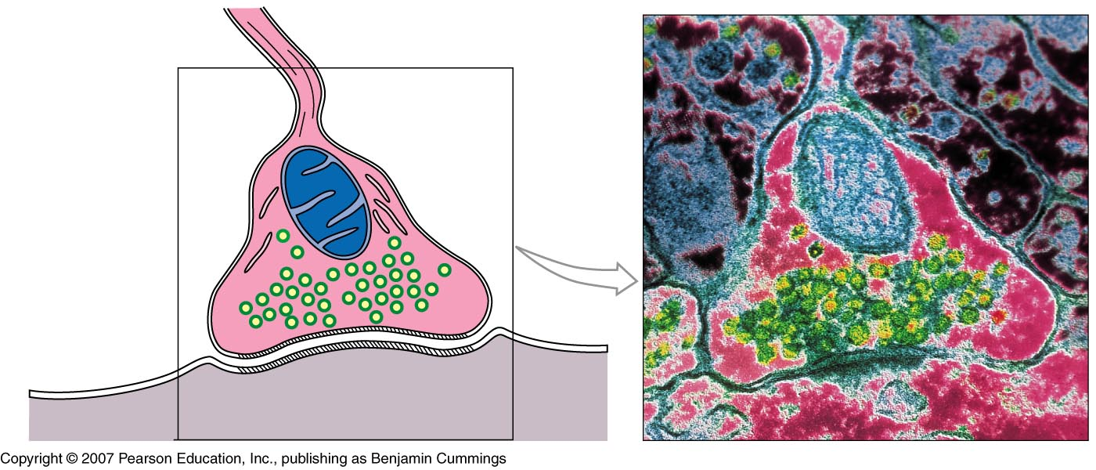
Neuromuscular junction
telodendria
Synaptic terminal (end bulb)
Synaptic vessicles containing Ach
Synaptic cleft
Neuromuscular junction
Motor end plate
of sarcolemma

Slide 4
The junction between terminal branch of the nerve fiber and muscle fiber.
The transfer of information from motor nerve ending to the muscle fiber through neuromuscular junction is called neuromuscular transmission.

Slide 5
The neuromuscular junction (NMJ) is a synaptic connection between the terminal end of a motor nerve and a muscle (skeletal/ smooth/ cardiac).
site for the transmission of action potential from nerve to the muscle.
site for many diseases and a site of action for many pharmacological drugs

Slide 6
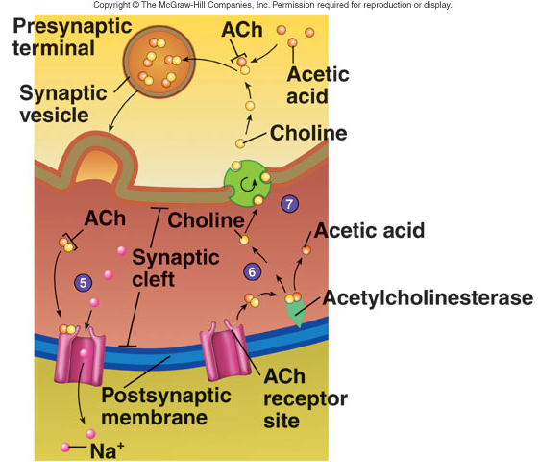
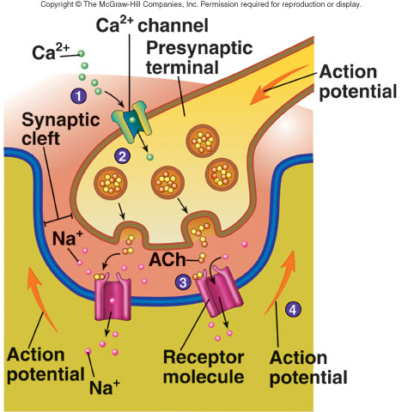
Function of Neuromuscular Junction

Slide 7
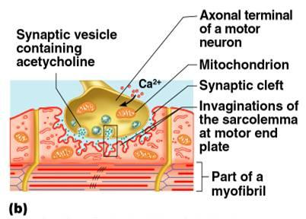

Slide 8
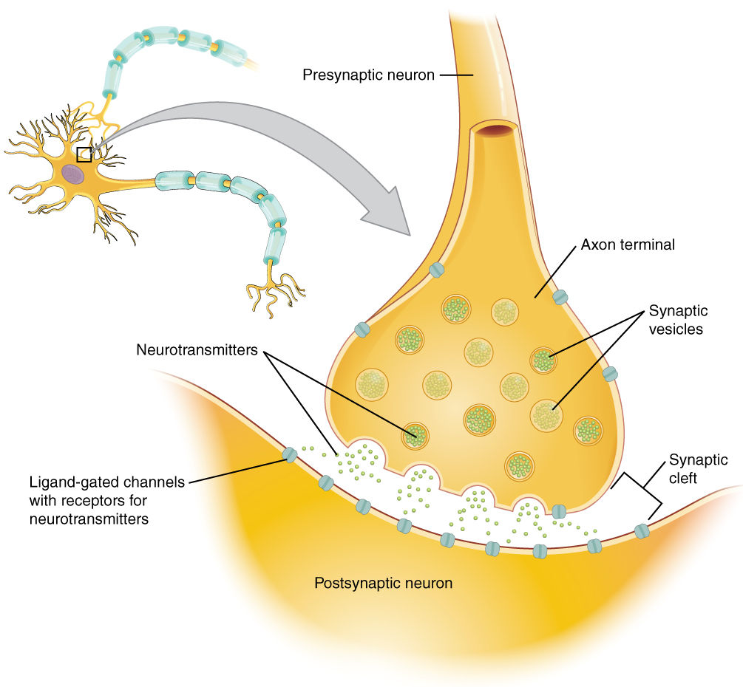

Slide 10
structure of NMJ can be divided into three main parts:
a presynaptic part (nerve terminal), the postsynaptic part (motor endplate), and an area between the nerve terminal and motor endplate (synaptic cleft).

Slide 11
Nerve Terminal: A myelinated motor neuron, on reaching the target muscle, loses its myelin sheath to form a complex of 100-200 branching nerve endings.
These nerve endings are called nerve terminals or terminal boutons.
The nerve terminal membrane has areas of membrane thickening called active zones.
Active zones have a family of SNAP proteins (syntaxins and synaptosomal-associated protein 25) and rows of voltage-gated calcium (Ca) channels.

Slide 12
A nerve terminal also has potassium channels on its membrane and contains mitochondria, endoplasmic reticulum, and synaptic vesicles (SVs).
Each SV stores around 5000-10000 molecules of acetylcholine (ACh), the neurotransmitter at NMJ.
The SVs are concentrated around the active zone.
The membrane of SVs has synaptotagmin and synaptobrevin proteins

Slide 13
These proteins are essential for fusion and docking of SVs at active zones.
On arrival of an action potential at the nerve terminal, Ca channels open to cause influx.
Increased Ca inside the nerve terminal causes a series of events leading to docking of SVs at active zones and exocytosis of the ACh from the synaptic vesicles into the synaptic cleft.

Slide 14
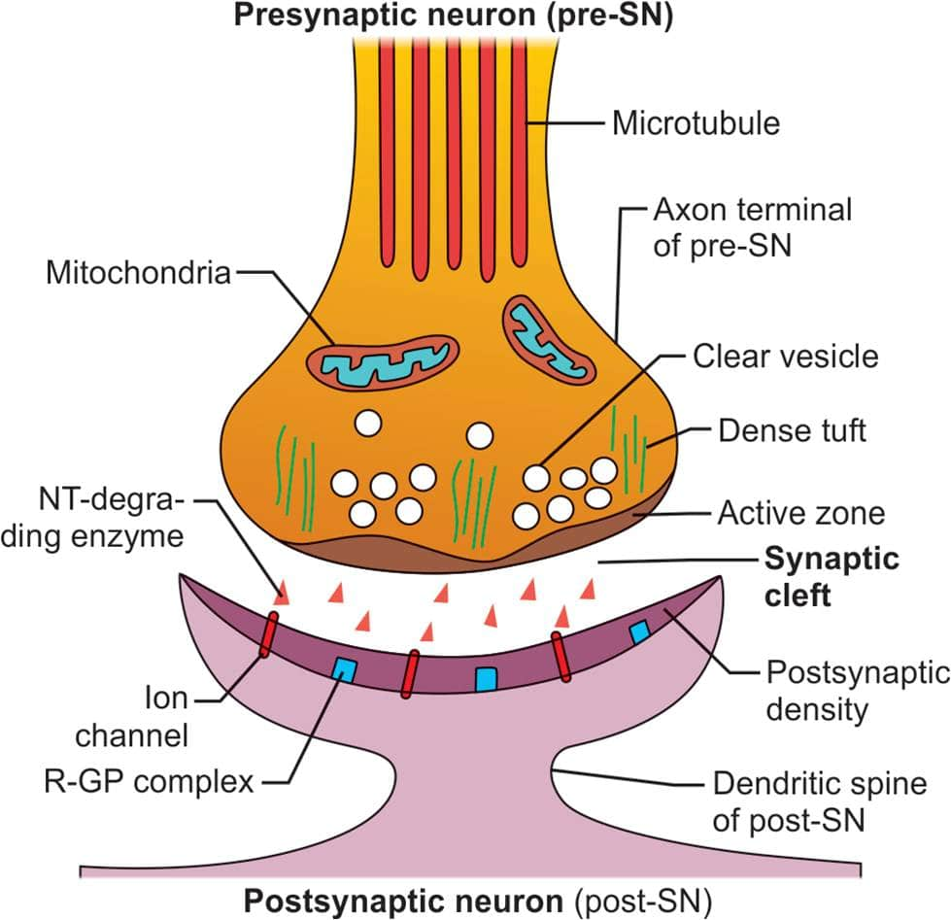

Slide 15
Synaptic Cleft / Junctional Cleft: The space between the nerve terminal and the plasma membrane of muscle is called synaptic/junctional cleft and measures ∼50 nm.
It is the site where presynaptic neurotransmitters, ACh is released before it interacts with nicotinic ACh receptors on the motor endplate.
Synaptic cleft of NMJ contains acetylcholinesterase enzyme, responsible for the catabolism of released ACh so that its effect on the post-synaptic receptors is not prolonged

Slide 16
Motor End Plate forms the postsynaptic part of NMJ. It is the thickened portion of the muscle plasma membrane (sarcolemma) that is folded to form depressions called junctional folds.
The terminal nerve endings do not penetrate the motor endplate but fit into the junctional folds. Junctional folds have nicotinic ACh receptors concentrated at the top. These receptors are ACh gated ion channels.

Slide 18
Binding of ACh to these receptors opens the channels allowing the influx of sodium ions from the extracellular fluid into the muscle membrane.
This creates Endplate potential and generates and transmits AP to the muscle membrane

Slide 19
THANK YOU

